Slide 1
Presidential election campaign finances
Dan Edie, Megan Chang, & Nick Prentkowski

Slide 2
Net receipts presidential candidates 2016

Slide 3
Net receipts presidential candidates 2020

Slide 4
Total reciepts

Slide 5
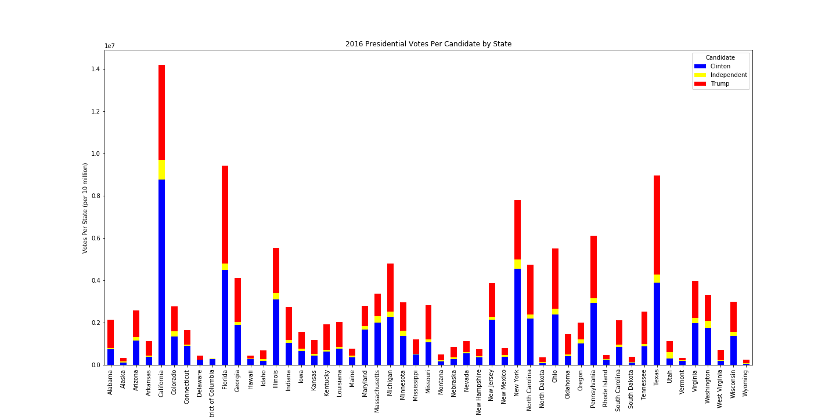

Slide 6
